Slide 1

MPPT Algorithm for Solar Battery Charging System
Department of Electrical Engineering
NATIONAL INSTITUTE OF TECHNOLOGY CALICUT
Team members
Prince Chaudhary
MD Saif Ali
Niranjan Kumar Jethiwal
Sahu Bhoopati Deskumar
Guide – Dr. Angshudeep Majumdar
Assistant Professor, EED
09-10-2024

Slide 2
INTRODUCTION
Renewable energy research is crucial to combat climate change and meet growing electricity demands.
Dependence on fossil fuels has intensified the climate crisis, driving the search for sustainable alternatives.
Solar energy is a leading renewable option due to its vast potential and cost-effectiveness.
Effective energy storage, especially through batteries, is essential for the success of renewable systems.
Addressing challenges like power instability in PV systems requires optimized designs and advanced control mechanisms like Maximum Power Point Tracking (MPPT) algorithms.

Slide 3
What is MPPT ?
Maximum Power Point Tracking (MPPT) is an advanced algorithm used in solar power systems to optimize the energy output of photovoltaic (PV) panels.
By continuously adjusting the electrical operating point, MPPT ensures that the panels operate at their maximum power point, which is crucial for maximizing energy production.
PV panels generate varying amounts of electricity based on factors like sunlight intensity and temperature.
MPPT enables the system to respond to these changes in real time, ensuring that the panels deliver the highest possible energy output. This optimization is essential for enhancing the overall efficiency of solar energy systems and making them competitive with traditional energy sources.

Slide 4
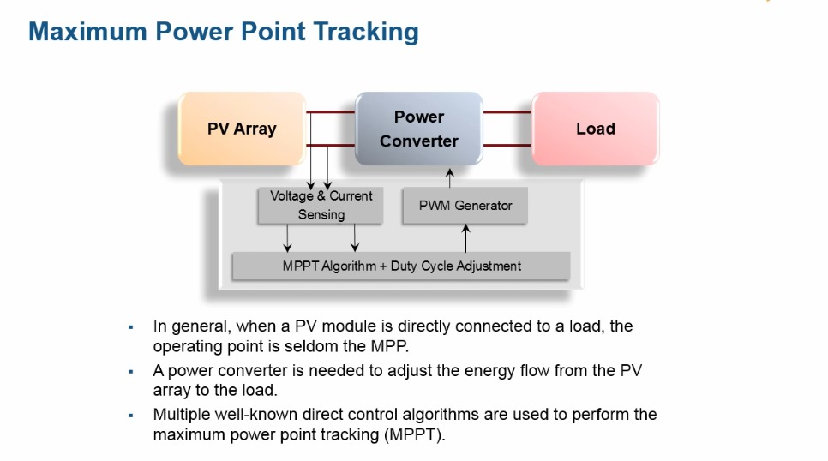

Slide 5
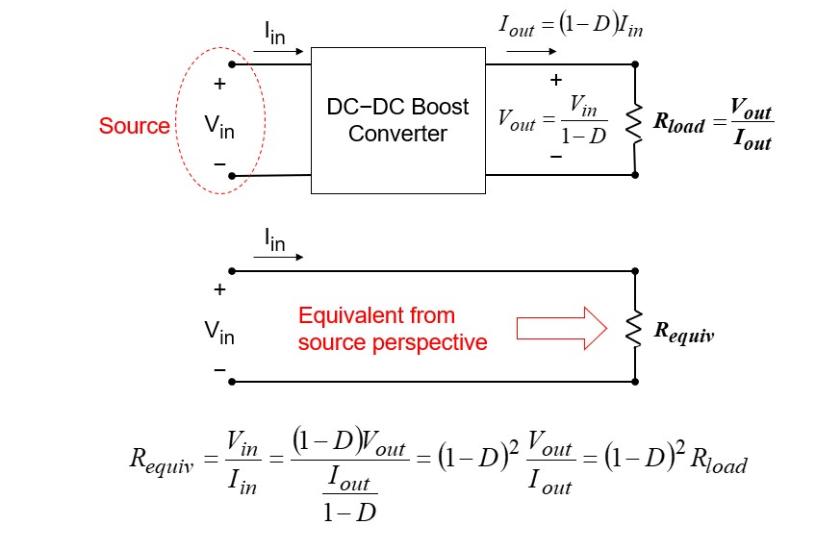
Impedance Matching

Slide 6
Objectives Of the Research Project
Maximize Energy Extraction: Implement an MPPT algorithm to optimize energy harvesting from solar panels under changing conditions.

Slide 7
LITERATURE REVIEW
Perturb & Observe (P&O) Algorithm
Overview: The P&O algorithm is one of the simplest and most widely implemented MPPT methods. It works by perturbing the voltage of the PV system and observing the resulting power changes.
Mechanism: If power increases after a voltage perturbation, the algorithm continues in the same direction; if it decreases, the direction is reversed.
Advantages: Easy to implement and cost-effective.
Limitations: Tends to oscillate around the maximum power point, especially in steady-state conditions, leading to power losses.

Slide 8
Incremental Conductance (INC) Algorithm
Overview: The INC algorithm provides a more accurate and responsive method for tracking the MPP, particularly in dynamic conditions.
Mechanism: It calculates both instantaneous and incremental conductance to determine the MPP by comparing the rate of change in power to voltage.
Advantages: Offers quick adjustment to changes in irradiance, making it suitable for fluctuating sunlight conditions.
Limitations: More complex to implement than P&O, requiring additional computational resources.

Slide 9
Constant Voltage (CV) Algorithm
Overview: The CV algorithm is a straightforward method that maintains the PV panel output at a predetermined voltage level near the MPP.
Mechanism: It is based on the assumption that a specific voltage can yield near-optimal power under stable conditions.
Advantages: Simple to implement and requires minimal computational effort.
Limitations: Lacks dynamic tracking capabilities, leading to reduced efficiency in varying environmental conditions.

Slide 10
Hill Climbing (HC) Algorithm
Overview: The HC algorithm operates similarly to P&O, adjusting the system voltage to ascend the power curve.
Mechanism: It makes adjustments based on the observed power output, akin to "climbing" to find the MPP.
Advantages: Useful in applications where power oscillations are significant.
Limitations: Can become unstable under rapid changes in irradiance, resulting in suboptimal tracking performance.

Slide 11
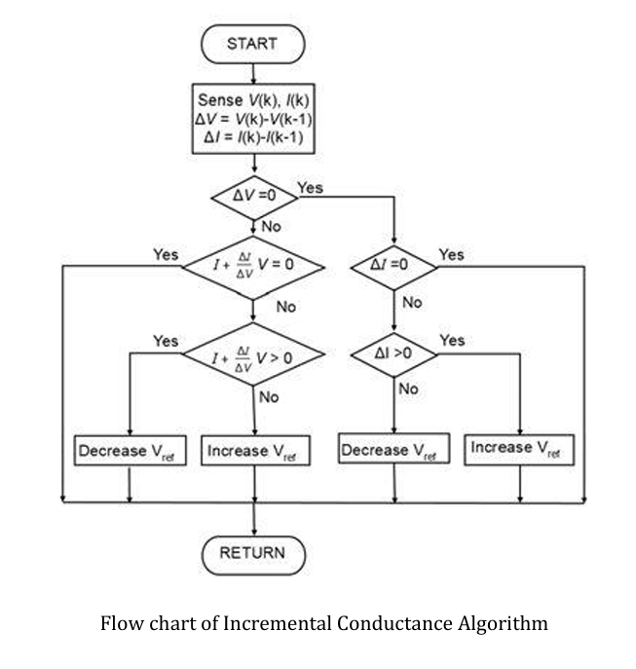
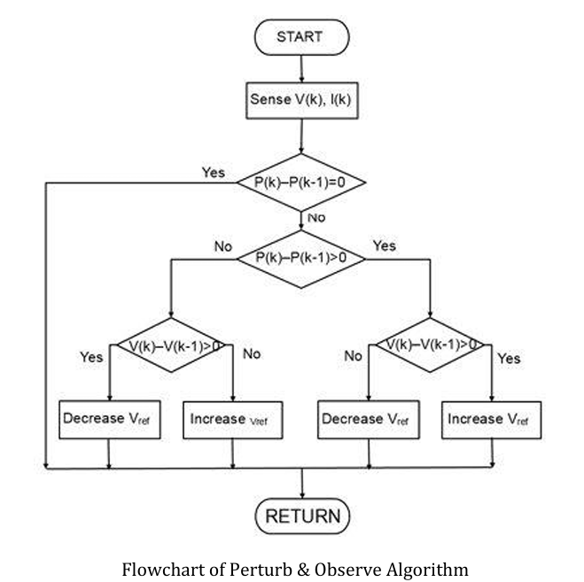
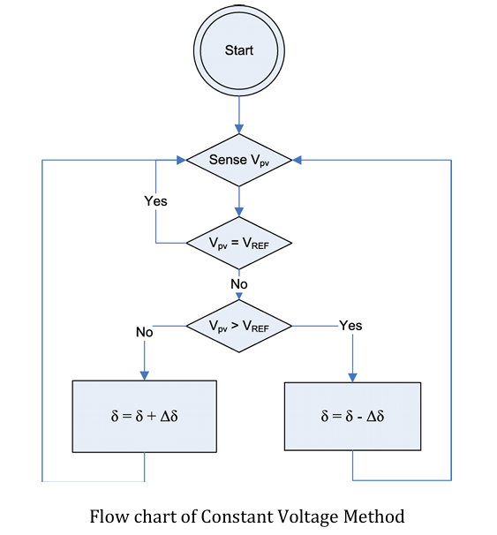
Algorithms with Code
This section provides code snippets and flowcharts for implementing various MPPT algorithms. These algorithms control the duty cycle in a simulated environment like MATLAB/Simulink.

Slide 12
Methodology for Solar Battery Charging System
System Overview: The solar battery charging system integrates a DC-DC buck converter to step down the high DC voltage from the PV panel to a lower charging voltage suitable for the battery. Maximum Power Point Tracking (MPPT) algorithms are employed to optimize power transfer by continuously adjusting the operating point of the PV module.
DC-DC Buck Converter:
Converts high voltage from PV panels to match battery charging requirements.
Controlled by various MPPT algorithms to maximize power output.

Slide 13
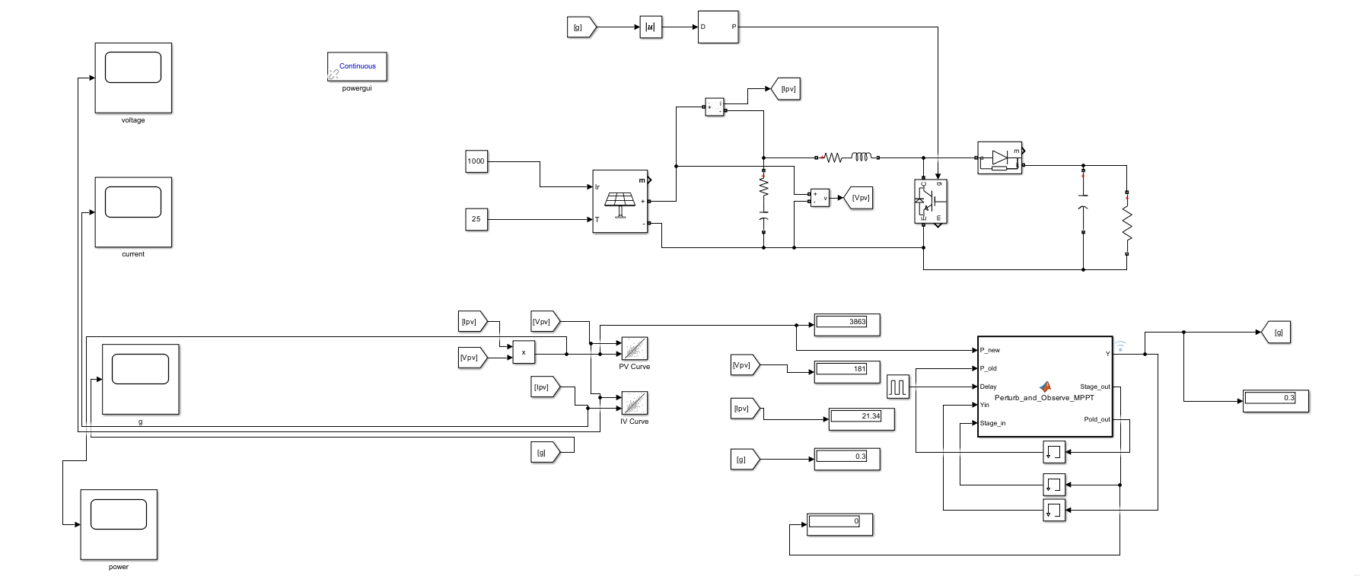
C=10e-6
R=30 ohm
R=0.01ohm
L=15e-3
R=0.001ohm
C=400e-6

Slide 14
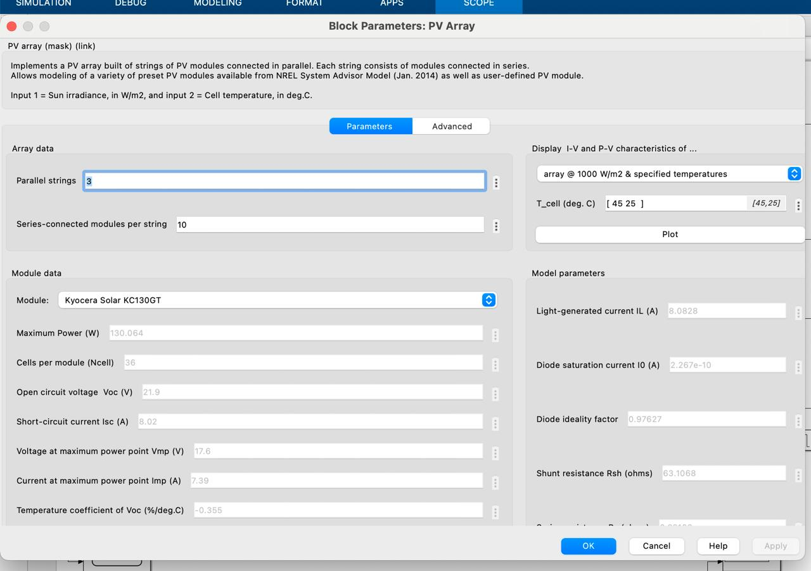
Block Parameters

Slide 15
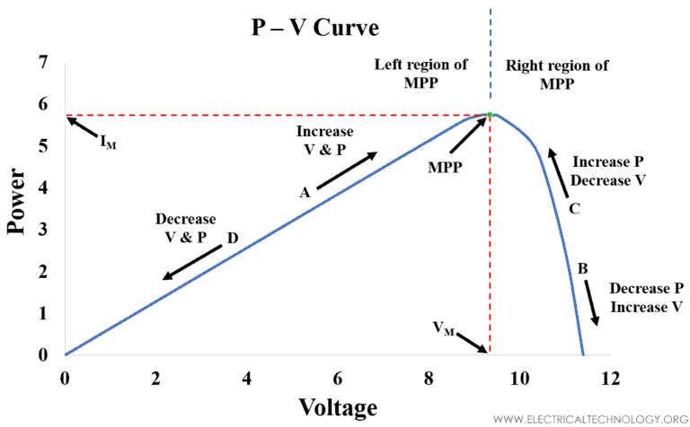
P&O

Slide 16
MPPT Algorithms Used:
1.Perturb & Observe (P&O):
Prone to oscillations around the MPP; adaptive step-size methods can mitigate this.
Simple and widely used; periodically perturbs voltage to observe power changes.
This common MPPT algorithm adjusts the operating voltage of the solar panel slightly and observes the change in power output. If the power increases, the algorithm continues in the same direction.
If the power decreases, it changes direction .This method involves continuous power measurement to keep adjusting until it reaches a point where any further change in voltage decreases power.
That’s how it "knows" the maximum point has been reached.

Slide 17
Simulation and Analysis:
The entire system (PV panel, buck converter, MPPT controller, and battery) is modeled and simulated in MATLAB/Simulink.
Simulation enables testing of different algorithms under various conditions, providing insights into efficiency, stability, and responsiveness.
Results help identify the optimal algorithm and system configuration for maximum efficiency in specific applications.

Slide 18
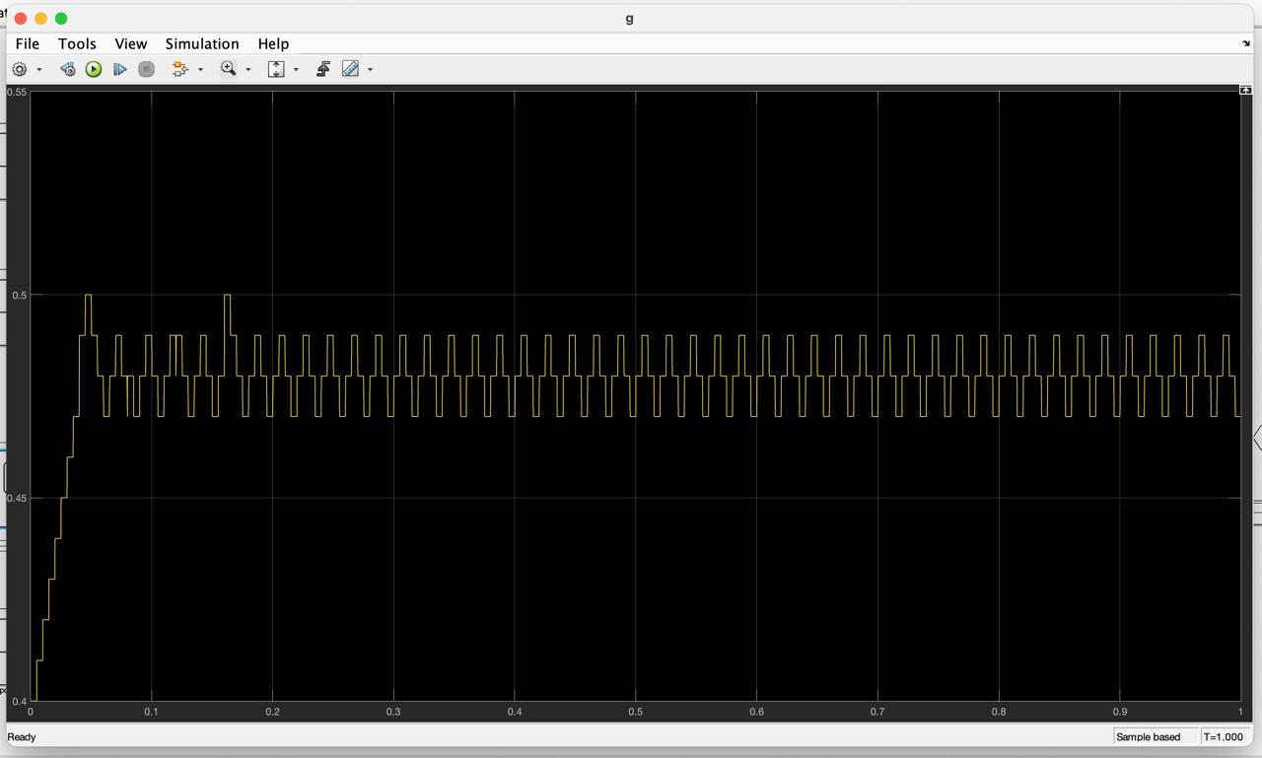
Duty cycle

Slide 19
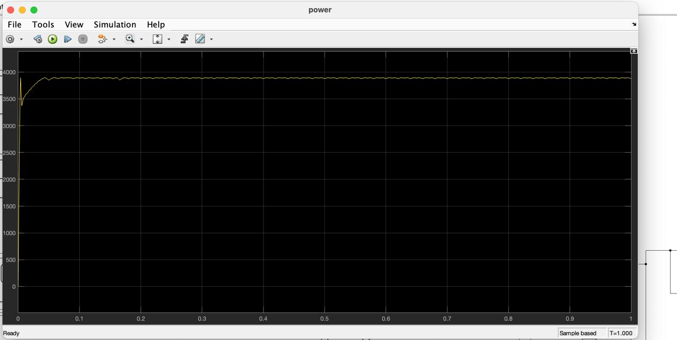
Power

Slide 20
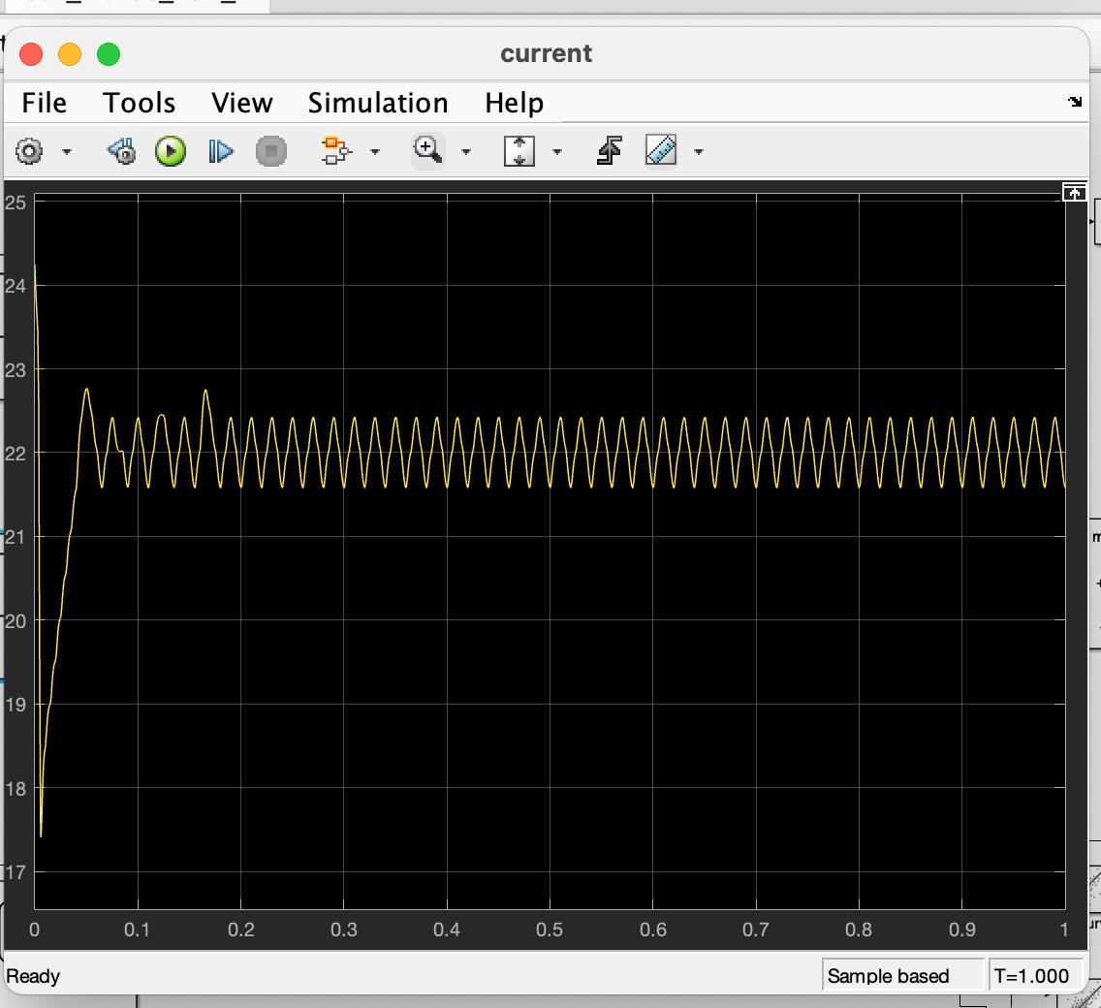
Current

Slide 21
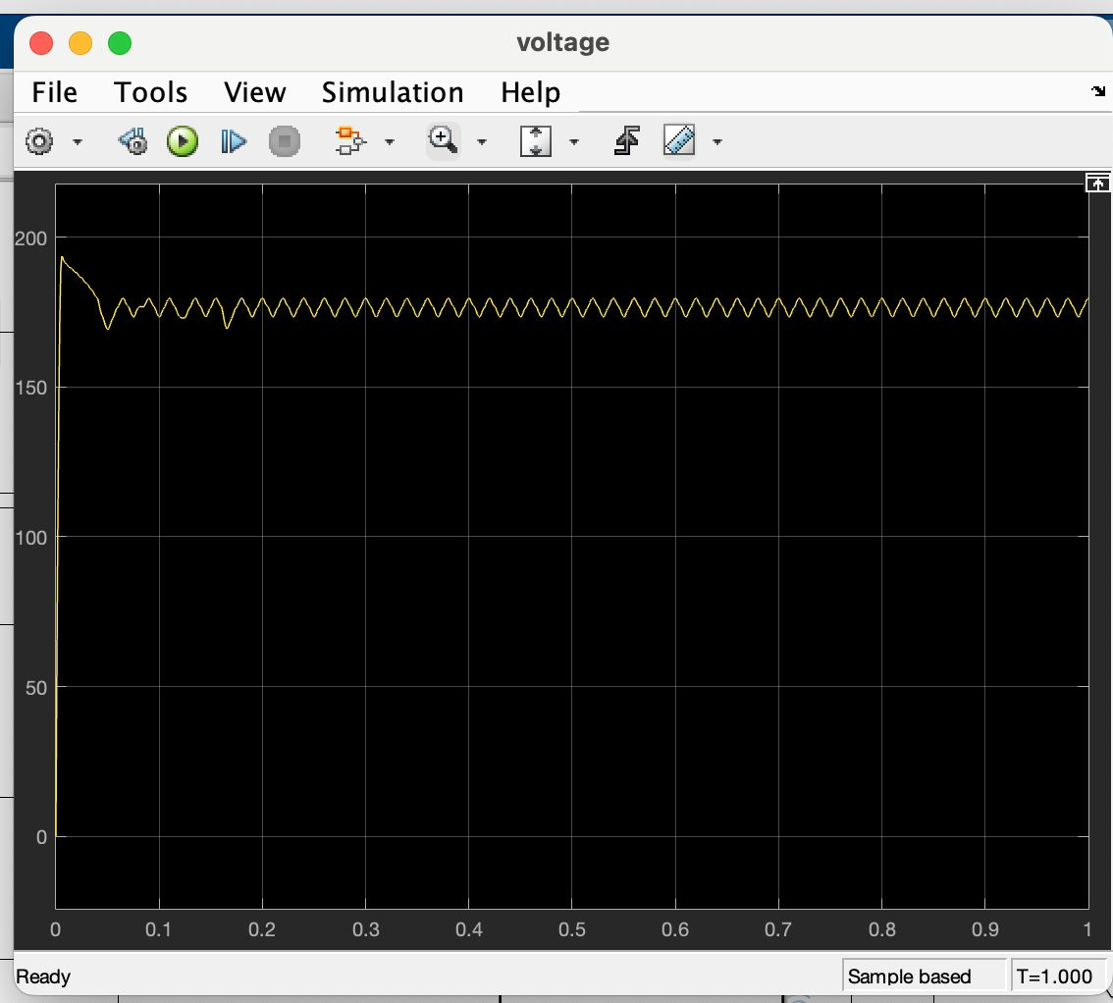
Voltage

Slide 22
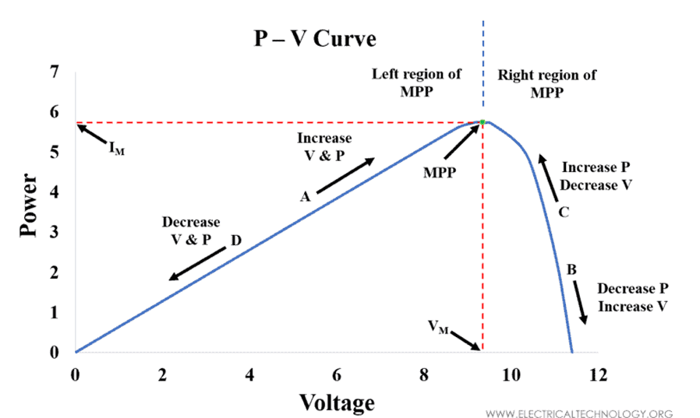
Expected Results
The expected outcomes for each MPPT algorithm vary in terms of efficiency and stability:

Slide 23
Expected Results of MPPT in Solar Battery Charging Systems
Maximized Power Extraction: Ensures solar panels operate at peak efficiency under varying conditions.
Improved Charging Efficiency: Reduces energy losses by optimizing battery charging.
Stable & Responsive: Quick adjustments to changing sunlight for consistent power output.
Extended Battery Life: Efficient charging profiles reduce overcharging and prolong battery life.
Enhanced System Performance: Improved overall system efficiency and faster tracking of the maximum power point.

Slide 24
Limitations

Slide 25
Conclusion
In conclusion, MPPT algorithms are essential for optimizing solar battery charging systems, allowing PV modules to operate at their maximum power points even under varying environmental conditions.
P&O offer simpler implementations but may suffer from increased oscillations. CV provides stability but lacks dynamic optimization.
Ultimately, the selection of an MPPT algorithm depends on the specific application requirements, such as the level of stability, efficiency, and environmental variability.

Slide 26
References
[1] Heh, Chee Yang, Jabbar Al-Fattah Yahaya, and Asmarashid Ponniran. "The Study of MPPT Algorithm for Solar Battery Charging System."
[2] K. Priyamvada, P. S. Sahasra Vaiishnavi, P. S. Vandana, S. Aakanksha, and R. Aparna, "MPPT Based Battery Charging Using Solar Energy," G. Narayanamma Institute of Technology and Science, Hyderabad, India.
[3] "Maximum Power Point Tracking Algorithm (MPPT)," MathWorks. Available: https://in.mathworks.com/discovery/mppt-algorithm.html
[4] "Maximum Power Point Tracking (MPPT) Algorithms," Electrical Technology, Mar. 2021. Available: https://www.electricaltechnology.org/2021/03/maximum-power-pointalgorithms.html.

